Slide 1


K. RAMAKRISHNAN COLLEGE OF ENGINEERING
(AUTONOMOUS), SAMAYAPURAM
Mr. K. SWAMINATHAN, M.E., MBA.,(Ph.D).,
Asst.Professor/CSE
DISASTER MANAGEMENT SYSTEM
Presented By,
NAME : NIDARSHAN M K
REGISTER NO : 8115U24EE040
ROLL NO : EE2440
YEAR : II

Slide 2
PRESENTATION OVERVIEW
  Objective
  System Architecture (Flow Diagram)
  Technology Used
  Module Used

Slide 3
OBJECTIVE
The objective of the Disaster Management System is to build a Java-based platform that ensures timely alerts, smooth communication, and efficient resource management during disasters. It helps authorities and citizens respond quickly, coordinate rescue operations, and analyze disaster data for better preparedness and recovery.

Slide 4
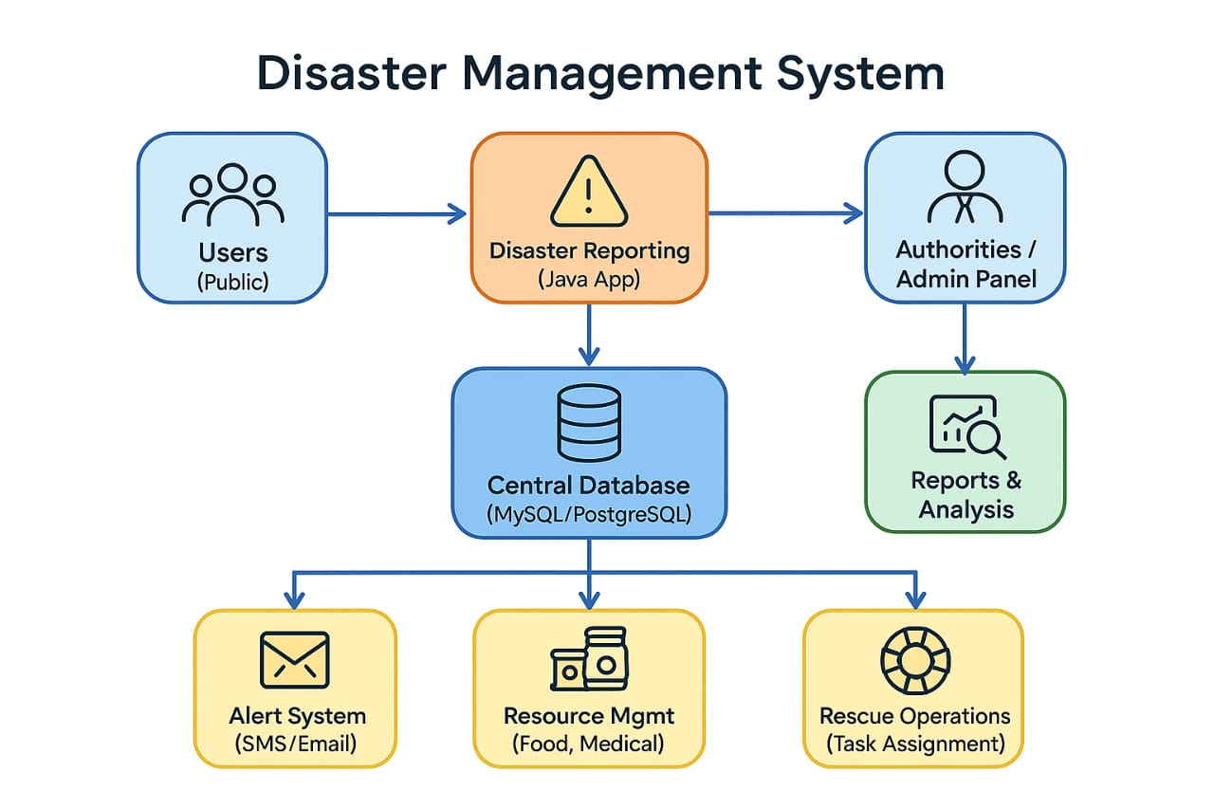
PROPOSED SYSTEM
ARCHITECTURE/FLOW DIAGRAM

Slide 5
TECHNOLOGY USED
Java – core programming language for system development.
MySQL / PostgreSQL – database for storing disaster and resource data.
Java Mail API / SMS Gateway API – for sending alerts and notifications .
Google Maps API – for location tracking (optional but useful).

Slide 6
MODULES USED
User Management Module : Handles user registration, login, and role-based access (citizen, volunteer, authority).
Disaster Reporting Module : Citizens or officials can report disasters with type, location, and severity.
Alert & Notification Module : Sends real-time alerts via SMS/Email to the public and rescue teams.

Slide 7
MODULES USED
4.Resource Management Module : Tracks and manages resources like shelters, medical kits, food, and vehicles.
5. Rescue & Coordination Module : Assigns rescue tasks, monitors operations, and enables communication between authorities and teams.
6. Data Analysis & Report Module : Generates reports, evaluates disaster impact, and supports future preparedness planning.

Slide 8
CONCLUSION
The Disaster Management System developed in Java provides an effective way to manage disasters by sending timely alerts, managing resources, and coordinating rescue operations. It improves communication between authorities and citizens, reduces the impact of disasters, and supports future preparedness through proper data analysis and reporting.

Slide 9


